Slide 1
Pushdown automata
Programming Language Design and Implementation (4th Edition)
by T. Pratt and M. Zelkowitz
Prentice Hall, 2001
Section 3.3.4- 4.1

Slide 2
Chomsky Hierarchy
Regular Grammar (Type 3) ⬄ Finite State Machine
Context-free Grammar (Type 2) ⬄ Push down automata
Context-sensitive grammar (Type 1) ⬄ bounded Turing machine
  aX -> ab
  BA -> AB
Unrestricted grammar (Type 0) ⬄ Turing machine

Slide 3
Context sensitive grammar
어떻게 스트링을 보고 해당 문법을 찾는가?
S -> A
A -> a A B C
A -> a b C
C B -> B C
b B -> b b
b C -> b c
c C -> c c

Slide 4
Undecidability
Turing machine (1936)
Church’s thesis ➔ Any computable function can be computed by a Turing machine
Undecidable ➔ A program that has no general algorithm for its solution
Halting problem, Busy Beaver problem, …

Slide 5
Pushdown Automaton
A pushdown automaton (PDA) is an abstract model machine similar to the FSA
It has a finite set of states. However, in addition, it has a pushdown stack. Moves of the PDA are as follows:
1. An input symbol is read and the top symbol on the stack is read.
2. Based on both inputs, the machine enters a new state and writes zero or more symbols onto the pushdown stack.
3. Acceptance of a string occurs if the stack is ever empty. (Alternatively, acceptance can be if the PDA is in a final state. Both models can be shown to be equivalent.)

Slide 6
Power of PDAs
PDAs are more powerful than FSAs.
a^{n}b^{n}, which cannot be recognized by an FSA, can easily be recognized by the PDA.
Stack all a symbols and, for each b, pop an a off the stack.
If the end of input is reached at the same time that the stack becomes empty, the string is accepted.
It is less clear that the languages accepted by
PDAs are equivalent to the context-free languages.

Slide 7
PDAs to produce derivation strings
Given some BNF (context free grammar). Produce the leftmost derivation of a string using a PDA:
1. If the top of the stack is a terminal symbol, compare it to the next input symbol; pop it off the stack if the same. It is an error if the symbols do not match.
2. If the top of the stack is a nonterminal symbol X, replace X on the stack with some string α, where α is the right hand side of some production X→ α.
This PDA now simulates the leftmost derivation for some context-free grammar.
This construction actually develops a nondeterministic PDA that is equivalent to the corresponding BNF grammar. (i.e., step 2 may have multiple options.)

Slide 8
NDPDAs are different from DPDAs
What is the relationship between deterministic
PDAs and nondeterministic PDAs? They are different.
Consider the set of palindromes, strings reading the same forward and backward, generated by the grammar
S → 0S0 | 1S1 | 2
We can recognize such strings by a deterministic PDA:
  1. Stack all 0s and 1s as read.
  2. Enter a new state upon reading a 2.
  3. Compare each new input to the top of stack, and pop stack.
However, consider the following set of palindromes:
S → 0S0 | 1S1 | 0 | 1
In this case, we never know where the middle of the string is. To recognize these palindromes, the automaton must guess where the middle of the string is (i.e., is nondeterministic).

Slide 9
PDA example
Given the palindrome 011010110, the PDA needs to guess where the middle symbol is:
Stack: Guess Middle: Match remainder:
0 11010110
0 1 1010110
01 1 010110
011 0 10110
0110 1 0110
01101 0 110
011010 1 10
0110101 1 0
01101011 0
Only the fifth option, where the machine guesses that 0110 is the first half, terminates successfully.
If some sequence of guesses leads to a complete parse of the input string, then the string is valid according to the grammar.

Slide 10
Language-machine equivalence
Already shown:
Regular languages = FSA = NDFSA
Context free languages = NDPDA. It can be shown that NDPDA not the same as DPDA
For context sensitive languages, we have Linear Bounded Automata (LBA)
For unrestricted languages we have Turing machines (TM)
Unrestricted languages = TM = NDTM
Context sensitive languages = NDLBA.
It is still unknown if NDLBA=DLBA

Slide 11
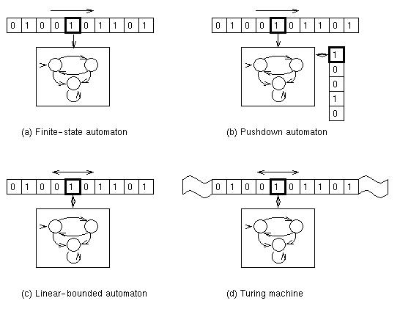
Grammar-machine equivalence

Slide 12
General parsing algorithms
Knuth in 1965 showed that the deterministic PDAs were equivalent to a class of grammars called LR(k) [Left-to-right parsing with k symbol lookahead]
Create a PDA that would decide whether to stack the next symbol or pop a symbol off the stack by looking k symbols ahead.
This is a deterministic process.
For k=1 process is efficient.
Tools built to process LR(k) grammars (YACC - Yet Another Compiler Compiler)
LR(k), SLR(k) [Simple LR(k)], and LALR(k) [Lookahead LR(k)] are all techniques used today to build efficient parsers.

